Slide 1
#FireYear2022 NIFC PIO Webinar
Hosted by External Affairs at the National Interagency Fire Center

Slide 2
Webinar Topics
Welcome
Bipartisan Infrastructure Law and Wildland Fire Management Funding
Interagency Talking Points
National Fire Year Themes
InciWeb Redesign Update
Updates from the NWCG PIO Subcommittee
Incident Management Response Roundtable
NIFC PIO Jeopardy
Questions and Answers

Slide 3
Welcome
Introduction
Zoom Tips
Jennifer Myslivy, BLM

Slide 4
Bipartisan Infrastructure Law and Wildland Fire Management Funding
Jessica Gardetto, BLM

Slide 5
Bipartisan Infrastructure Law and Wildland Fire Management Funding
$5 billion for federal wildland fire management efforts over the next five years
$600 million for firefighter pay
Messaging:
USDA and DOI communication plans
Use these plans (or your agency’s plan) to tailor messages to your local forest, district, etc.
If you get media inquiries (incident-specific, etc.)

Slide 6
Interagency Talking Points
Samantha Storms, BLM

Slide 7
Interagency Talking Points
"Hot" Topics:
Wildland fire management strategies and tactics
Climate Change
COVID-19
Hiring and firefighter pay
Workforce reform/ transformation
Wildland fire personnel mental health
Legislation – Bipartisan Infrastructure Law
Feel free to send these and other national-level topics to our information line: 208-387-5050

Slide 8
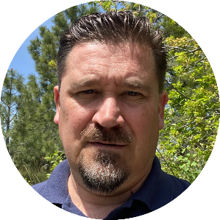
National Fire Year Themes
Stanton Florea, USFS

Slide 9
The wildland fire community will safely manage wildfires during the COVID-19 pandemic. Firefighter and public safety is always the highest priority during a wildfire. Wildfire activity is becoming more extreme.
2022 Fire Year Themes

Slide 10
2022 Fire Year Themes
Recreate Responsibly: the public plays a valuable role in wildfire prevention.
Fuels management can save lives, property and natural resources.
Supporting the wildland fire management workforce.

Slide 11
InciWeb Redesign Update
Brian Reublinger, USFS

Slide 12
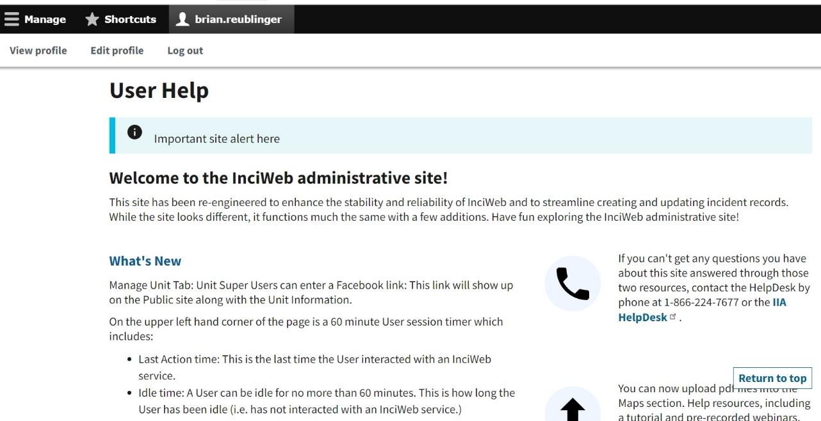

Slide 13
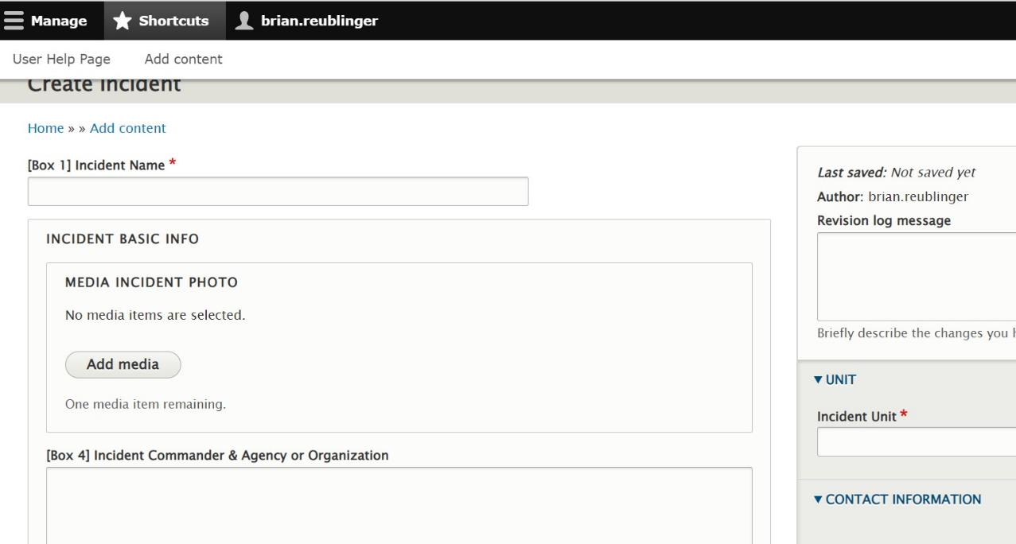

Slide 14
Updates from the NWCG PIO Subcommittee
Candice Stevenson, NPS

Slide 15
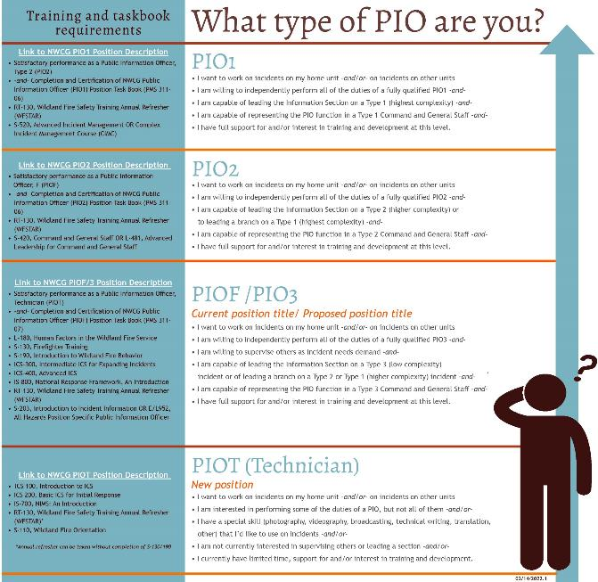
Current PIO Positions
Updated final position descriptions for PIO1, PIO2, PIO3, and PIOT.
We can use the PIO3 position code.
Current PIOFs could see a name change to PIO3 on a future red card.
A new task book was also developed for PIO3. That task book will be made available as soon as approved. A transition plan will follow.
138 qualified Public Information Officer Technicians (PIOT) in IQCS now.
Not including state/local/other agencies that use other qualifications systems
https://www.nwcg.gov/sites/default/files/committee-images/pio-graphic.pdf
Notes:
We have finalized updated position descriptions for PIO1, PIO2, PIO3, and PIOT.
Graphic that explains positions: What type of PIO are you? (nwcg.gov)
We have permission to use the PIO3 position code, but it will take some time to make changes in the systems. Current PIOFs could see a name change to PIO3 on a future red card.
A new task book was also developed for PIO3. That task book will be made available as soon as approved. A transition plan will follow.
We have 138 qualified Public Information Officer Technicians (PIOT) in IQCS now. This does not account for state, local, or other agency employees that use other qualification systems.

Slide 16
Reviewing and Updating Information Training
S-203
S-403
S-103 – possible code for an introductory course for the PIOT position
S-110 – PIOSC provided feedback for the updated S-110 training
O-305 or other IMT training – PIOSC is working with the IPSC to develop Type 3 level IMT training.
Complex IMT Transition
Notes:
Reviewing and Updating Information Training
S-203
S-403
S-103 – possible code for an introductory course for the PIOT position
S-110 – PIOSC provided feedback for the updated S-110 training
O-305 or other IMT training – PIOSC is working with the IPSC to develop Type 3 level IMT training.
Complex IMT Transition

Slide 17
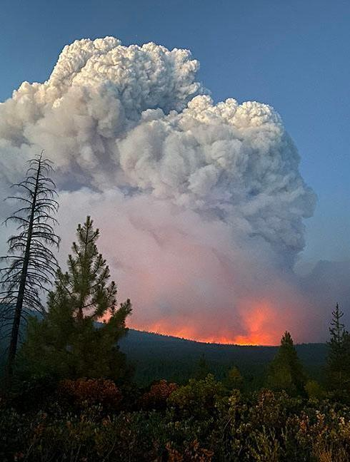
Complex IMT Involvement
The PIOSC and other position steward committees were asked to develop complex-level positions for the Complex IMT Transition.
We developed a PIO Complex (PIOC) position based on the Type 1 PIO position description and updated the PIO 1 task book to reflect duties at the complex level.
The IPSC prepared a transition plan to include all positions affected by the Complex IMT transition. This transition mainly affects Type 1 and Type 2 positions.
The NWCG Executive Board issued a memo with guidance to implement the transition plan for the Pilot Phase this year: https://www.nwcg.gov/sites/default/files/memos/eb-m-22-002.pdf
After this year of pilot testing CIMTs, NWCG committees will re-evaluate the needs for each position and provide updates to the transition plan and positions where needed.
Notes:
Complex IMT Involvement
The PIOSC and other position steward committees were asked to develop complex-level positions for the Complex IMT Transition.
We developed a PIO Complex (PIOC) position based on the Type 1 PIO position description and updated the PIO 1 task book to reflect duties at the complex level.
The IPSC prepared a transition plan to include all positions affected by the Complex IMT transition. This transition mainly affects Type 1 and Type 2 positions.
The NWCG Executive Board issued a memo with guidance to implement the transition plan for the Pilot Phase this year: https://www.nwcg.gov/sites/default/files/memos/eb-m-22-002.pdf
After this year of pilot testing CIMTs, NWCG committees will re-evaluate the needs for each position and provide updates to the transition plan and positions where needed.

Slide 18
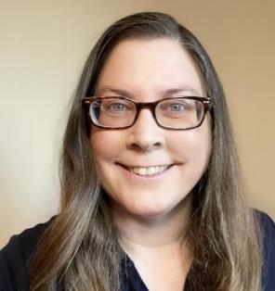
Incident Management Response Roundtable
Michelle Fidler, USFS
Notes:
I’m Michelle Fidler, I’m a Type 1 Public Information Officer and I help facilitate our interagency IMRR PIO Calls.

Slide 19
Incident Management Response Roundtable
https://tinyurl.com/imrroverview
Notes:
In 2020, IMRR began as a grass roots effort to share real time Incident Management Remote Response lessons learned as we adapted in a pandemic environment.
In 2022 the name was updated to the Incident Management Response Roundtable to more accurately reflect the evolved nature of our community that provides opportunities to connect the field, share interagency incident innovation, and build best practices.
You can check out our Storymap for more information https://tinyurl.com/IMRRoverview

Slide 20
Incident Management Response Roundtable (IMRR)
Connecting the Field – Sharing Interagency Incident Innovation –
Developing and Recommending Sustainable Practices
Public Information Officer Calls
1st & 3rd Wed of the month, 10-11 am Pacific Time
Email reminders with agenda sent out a few days before the call
Sign up for IMRR PIO call invites at: https://tinyurl.com/IMRRinvite
Call notes, recordings, tech talks, and related resources: https://tinyurl.com/IMRRPIOOneNote
Contact michelle.fidler@usda.gov if you’d like to present or suggest agenda topic
Notes:
Interagency PIOs of all levels nationwide are welcome to join our calls. The calls are an opportunity to connect the field, share interagency incident innovation, and develop and recommend sustainable practices.
The IMRR PIO calls are currently scheduled on the 1st & 3rd Wed of the month, 10-11 am PT. A reminder email with the agenda is sent out a few days before the call.
In the off season we bring in guest speakers to help us expand our skills and knowledge. The NWCG PIO Subcommittee also provides regular updates. When fire activity picks up we focus on report outs from folks on active or recent incidents and provide an opportunity for folks in the field to share tips and tricks.
You can sign Up for Functional Area Calls online https://tinyurl.com/IMRRinvite

Slide 21
2021 Remote Incident Support Team (RIST) Support
https://tinyurl.com/riststorymap https://tinyurl.com/ristinfo https://tinyurl.com/ristavailabilityform
Notes:
One project that evolved out of IMRR discussions is the Remote Incident Support Team or RIST.
It’s an opportunity for folks not available for traditional field assignments to be able to help support multiple incidents with specific tasks that can be done virtually including Inciweb, social media, media monitoring, and video editing.
You can check out our links for more info. https://tinyurl.com/ristinfo

Slide 22
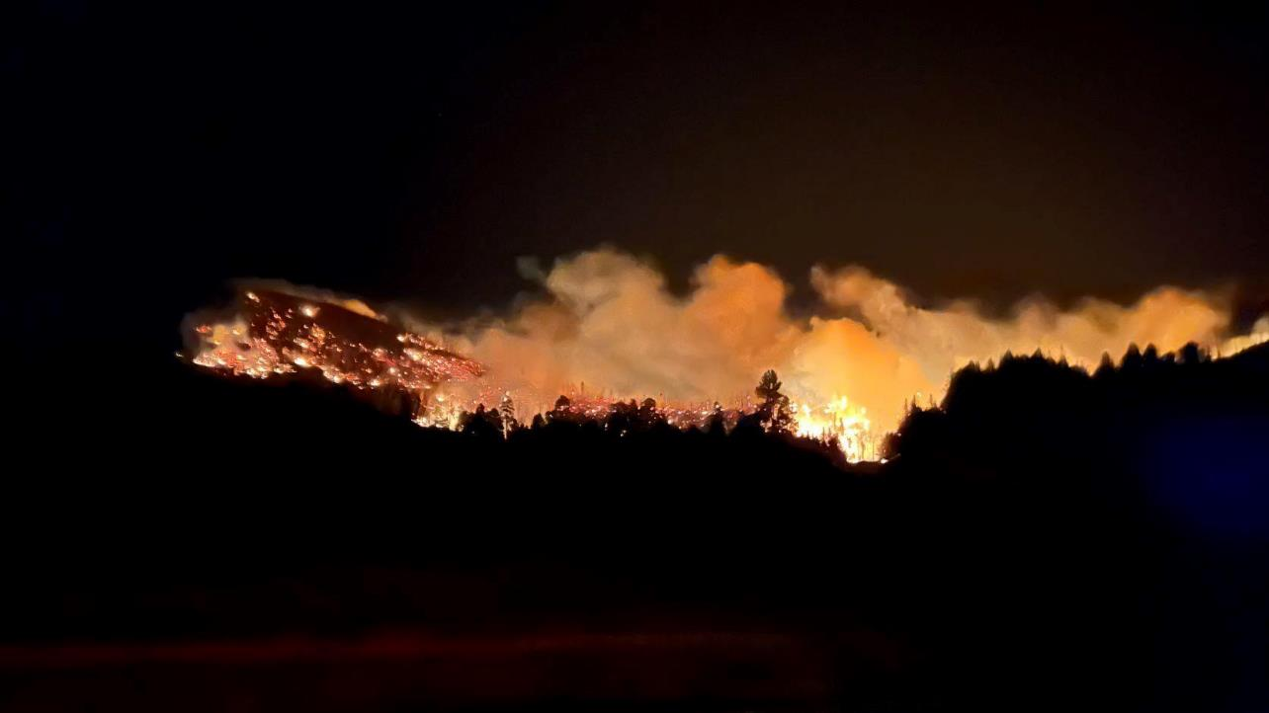
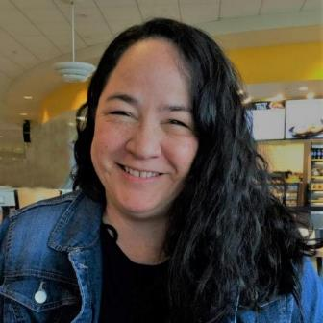
NIFC PIO Jeopardy
Carrie Bilbao, BLM
Sheri Ascherfeld, BLM

Slide 23
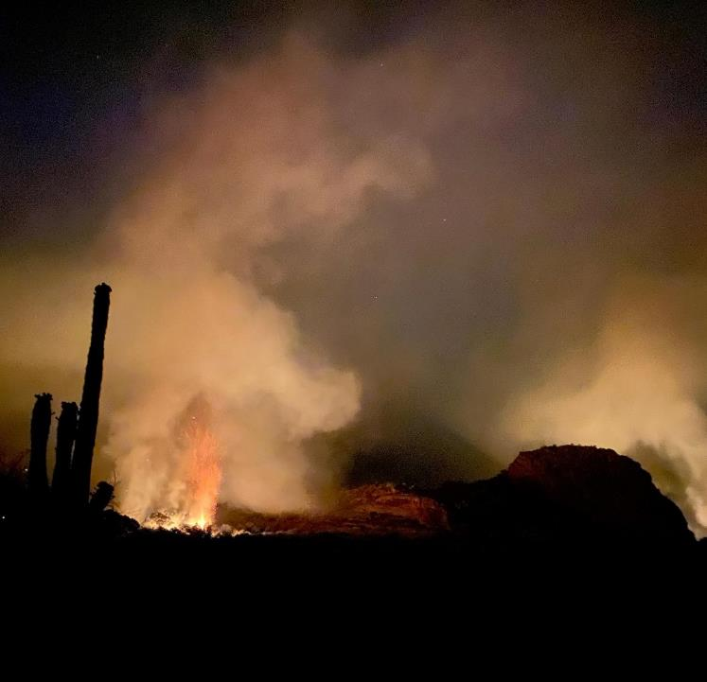
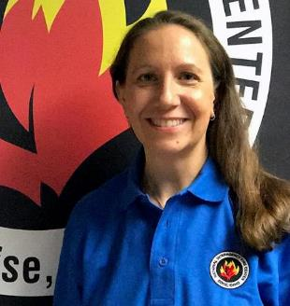
Questions and Answers
Tina Boehle, NPS

