Slide 1
National Interagency Hazardous Fuels Reduction Indefinite Deliveries-Indefinite Quantities Solicitation
Pre-Proposal Workshop
Notes:
This PowerPoint presentation is intended to assist States and Regions in putting on Pre-Proposal Workshops/Conference for the National Interagency Hazardous Fuels Reduction Indefinite Deliveries-Indefinite Quantities Solicitation. Use of this PowerPoint is not mandatory and it can be modified to meet local needs.

Slide 2
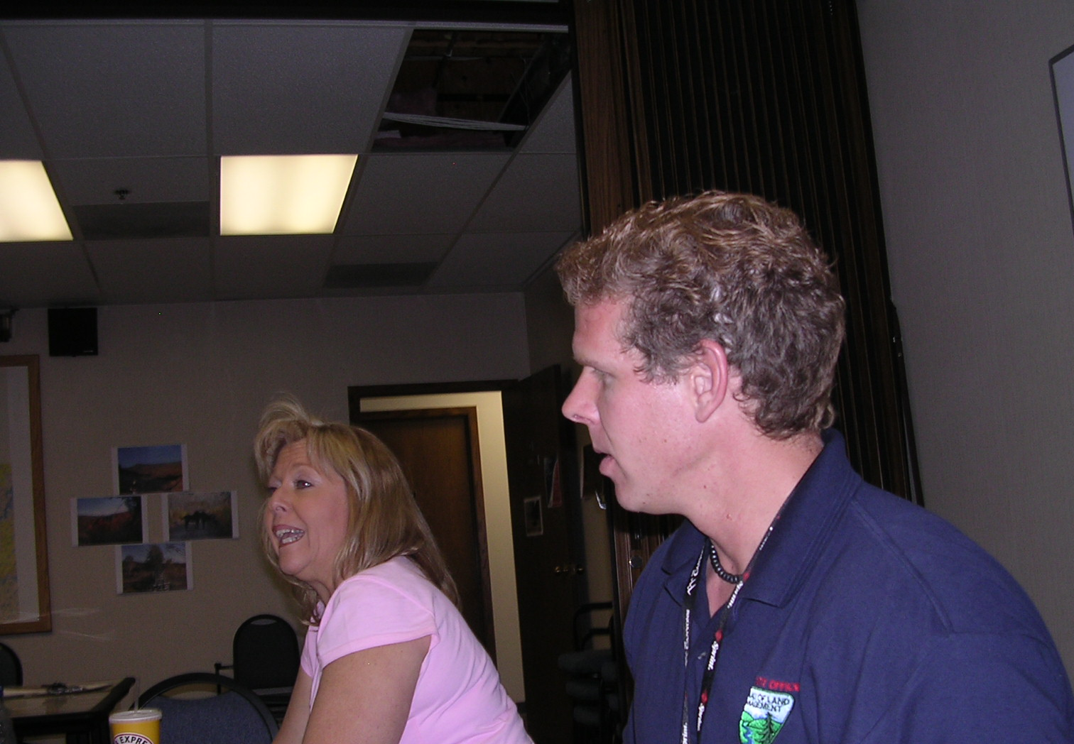
National Interagency Hazardous Fuels Reduction IDIQ Solicitation
Introductions
Name
Company or Agency
If you are currently on the Hazardous Fuels Reduction IDIQ Contract.
Notes:
Local Fuels Program Lead or Fire Management Officer should conduct Welcome/Introductions. Include those who are part of the agenda, other agency personnel, State Procurement Technical Assistance Center representative (if present) and interested contractors.

Slide 3
National Interagency Hazardous Fuels Reduction IDIQ Solicitation
1805
Agenda
Time | Subject | Presenter
10 | Welcome/Introductions | Local Fuels Program Lead or FMO
15 | National Fire Plan and Contracting | State/Regional Fuels Specialist
15 | Contracting with the Federal Government | Contracting Officer
1:05 | Hazardous Fuels Reduction IDIQ Solicitation – Specifications | State/Regional Fuels Specialist
10 | Break
25 | Contract Language and How to Prepare a Solicitation Package | Contracting Officer
10 | Assistance from the State Procurement Technical Assistance Center | PTAC Representative
 | Questions and Answers | Contracting Officer and S/R Fuels Specialist
Notes:
This is only a suggested agenda and may be adjusted to meet local needs.

Slide 4
Hazardous Fuels Reduction IDIQ Solicitation Pre-Proposal Workshop
Information presented in this workshop is intended to help potential contractors understand this solicitation.
Refer to Solicitation L09PS00981 if in question as to material presented at the workshop.
Notes:
The Solicitation L09PS00981 and the BLM National Operations Center Contracting Officer have the final decision in all matters related to this solicitation.

Slide 5
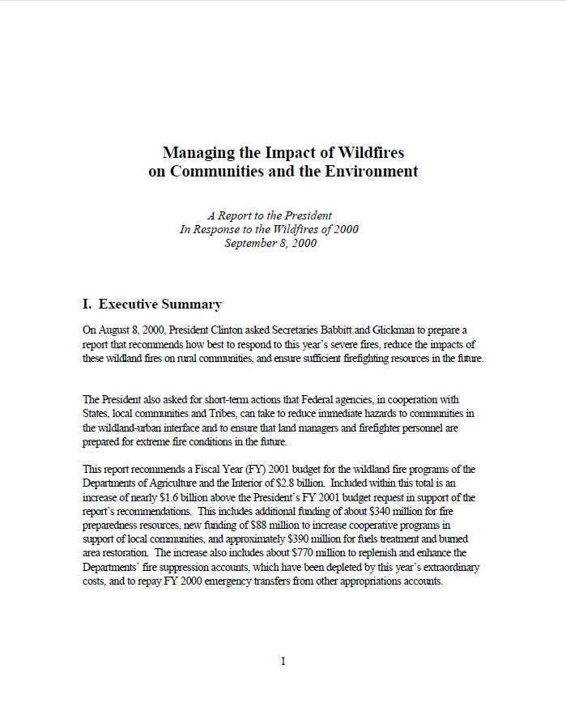
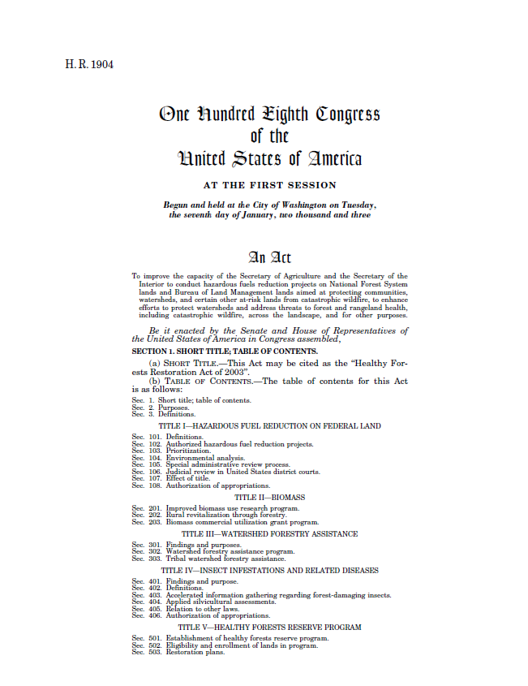
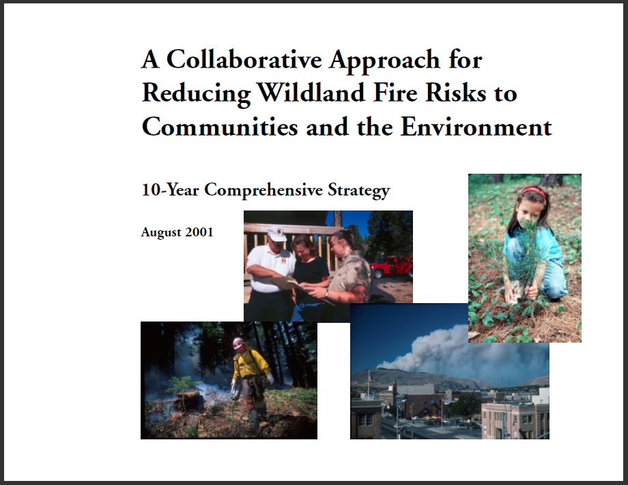
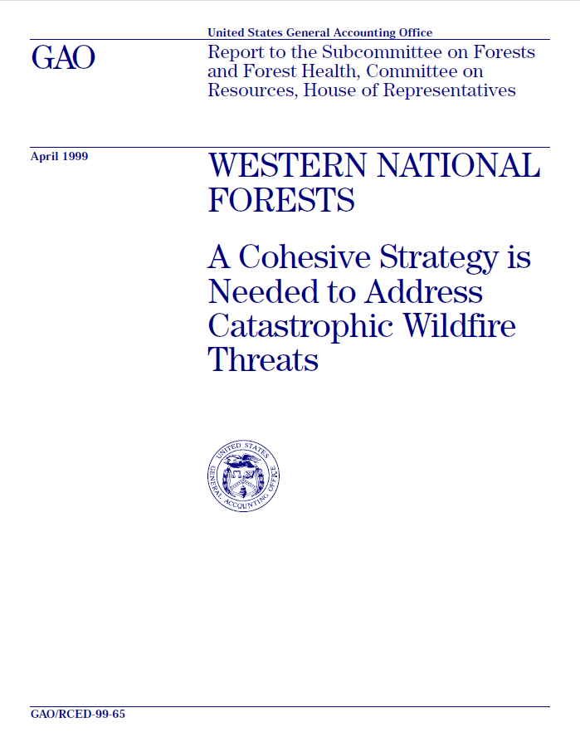
National Fire Plan and Contracting
Notes:
To respond to the wildland fires in 2000, the President requested, and the Secretaries of the Interior and Agriculture submitted, a September 8, 2000, report, Managing the Impact of Wildfires on Communities and the Environment, A Report to the President In Response to the Wildfires of 2000. This report, its accompanying budget request, Congressional direction for substantial new appropriations for wildland fire management for Fiscal Year 2001 and 2002, and resulting action plans and agency strategies have collectively become known as the National Fire Plan. Funding and bipartisan support for the National Fire Plan continue to this day with the fundamental direction provided by the plan serving as the basis for hazardous fuels reduction work.

Slide 6
National Fire Plan and Contracting
The goals of the National Fire Plan:
Improve Prevention and Suppression
Reduce Hazardous Fuels
Restore Fire Adapted Ecosystems
Promote Community Assistance
Notes:
The 10-Year Comprehensive Strategy as part of the National Fire Plan has four goals. Three of these National Fire Plan goals are directly and indirectly related to this Hazardous Fuels Reduction IDIQ Solicitation. The first goal of Improve Prevention and Suppression is not covering in this solicitation.

Slide 7
10-Year Comprehensive Strategy
Reduce Hazardous Fuels Guiding Principle:
Hazardous Fuel Reduction – Prioritize hazardous fuels reduction where the negative impacts of wildland fire are greatest.
Notes:
This goal is the underling guiding principle of the 10-Year Comprehensive Strategy related to the majority of the hazardous fuels reduction activities covered under this contract.

Slide 8
10-Year Comprehensive Strategy
Restore Fire Adapted Ecosystems
Guiding Principle:
Rehabilitation – Prevent invasive species and restore watershed function and biological communities through short-term rehabilitation.
Restoration – Restore healthy, diverse, and resilient ecological systems to minimize uncharacteristically severe fires on a priority watershed basis through long-term restoration.
Notes:
Many times line items from the contract are ordered for rehabilitation and restoration activities. For rehabilitation following a wildfire event chaining with bulldozers to prepare seedbed and cover seed may be employed. Many times restoration is the objective of our fuels treatments or intended to compliment our fuels treatments (i.e. seeding before or after bullhog treatments).

Slide 9
10-Year Comprehensive Strategy
Promote Community Assistance
Guiding Principle:
Increase Local Capacity – Where appropriate, stimulate local capacity to accomplish hazardous fuels reduction and rehabilitation work.
Biomass Utilization – Employ all appropriate means to stimulate industries that will utilize small-diameter, woody material resulting from hazardous fuel reduction activities, such as for biomass electric power, pulp and paper-making, and composite structural building materials.
Notes:
Two elements within this goal are considered in the Hazardous Fuels Reduction IDIQ Contract. Increase local capacity has an economic element with contracting to local interests and bringing funding into the local economy being a significant consideration under the 10-Year Comprehensive Strategy. This contract allows for the utilization of biomass if product is available and it is to the advantage of the government to provide for such biomass. Stewardship contracting authority is not part of this contract.

Slide 10
DOI - Hazardous Fuels Reduction Treatment Priorities
Hazardous fuels reduction projects must reduce the risk and consequences of wildfire, or maintain areas which are already in a desirable condition.
Funding will be targeted to the wildland-urban interface (WUI).
Notes:
These are the current Department of Interior Hazardous Fuels Reduction Treatment Priorities. These reaffirm and remain similar to the original National Fire Plan priorities. The U.S. Forest Service within the Department of Agriculture has similar priorities.

Slide 11
DOI FY2010 - Hazardous Fuels Reduction Treatment Priorities
Restoring fire-adapted ecosystems in Condition Class 3 or 2 in Fire Regimes I, II or III, or maintaining ecosystems in Condition Class I where conditions could deteriorate.
Projects yielding biomass for off-site economic use.
Projects using contractors, particularly contracts that support community or Tribal economic stability.
Notes:
Continuation of the DOI Hazardous Fuels Reduction Treatment Priorities.

Slide 12
Contracting with the Federal Government
Notes:
This is the third subject area of the workshop and is intended to be covered by a Contracting Officer. Contracting Officers may want to explain relationship between the Government, its representatives, and the contractor. Also that the contractor is representing the U.S. Government in the work they carry out as part of this solicitation.

Slide 13
Indefinite Delivery/ Indefinite Quantity Contracts
IDIQ Contracting has been used by the BLM in Oregon for hazardous fuels reduction since mid-1990’s.
This is the third IDIQ Solicitation BLM has issued for the 13 western states.
This solicitation has greater Interagency involvement and includes Florida, Tennessee, and Texas.
BLM, NPS, USFWS, BIA, and USFS are authorized to issue task orders against this solicitation.
Notes:
History on the use of IDIQ contracts for hazardous fuels reduction and expansion of this solicitation with several states in the east.

Slide 14
Indefinite Delivery/ Indefinite Quantity Contracts
The IDIQ contract provides an indefinite quantity services during a fixed period of time.
Awards are usually for base years as well as option years.
The Government places task orders (for services) against a basic contract for individual requirements.
Minimum and maximum quantity limits are specified in the basic contract as number of task orders.
Notes:
Background on use of IDIQ contracts.

Slide 15
Indefinite Delivery/ Indefinite Quantity Contracts
The Government uses an IDIQ contract when it cannot predetermine, above a specified minimum, the precise quantities or location of services the Government will require during the contract period.
An IDIQ contract allows for a certain amount of contract process streamlining, as negotiations can be made only with the selected companies under the multiple award.
Notes:
Benefits of using an IDIQ Contract over conventional contracts.

Slide 16
Request for Proposals
Contractors shall submit bids for all difficulty levels the offeror is in a position to furnish.
Include only states where contractor is interested in working.
The proposed unit price identifies the maximum price of each item number.
Bids are for the first base year and up to two additional year.
Notes:
This discussion starts on page 3 and 5 of the Solicitation. Bullets identified here should be highlighted to prospective contractors. Contractors can bid on all items, select items, or one item based on organization and past performance. Although just because a contractor does not have past performance with an item, does not disqualify them from future work. If there is no past performance, but contractor might be interested in an item of work, they should still submit a bid price. Contractor will need to show how they will meet the needs of the requirement (i.e. plan on renting equipment and demonstrates that contractor has discussed rental options with equipment rental companies).

Slide 17
One item Proposal
Notes:
If Contractor only desires to bid on one item (i.e. Contractor has several masticators and only desires to bid on Item 17 – Grinding). Contractor would identify states which they wish to work. Contractor would only need to address pertinent questions in technical proposal (i.e. would not need to address hand tools to be used).

Slide 18
One item Proposal
ITEM 0017, MECHANICAL FUELS TREATMENT (GRINDING)
Item Number | Description | Unit | Quantity | Base Year Unit Fixed Price | Option Year I Unit Fixed Price | Option Year Ii Unit Fixed Price
0017AA | LEVEL I | ACRE | 1 | $ 300 | $325 | $ 350
0017AB | LEVEL II | ACRE | 1 | $325 | $ | $
0017AC | LEVEL III | ACRE | 1 | $ | $ | $
0017AD | LEVEL IV | ACRE | 1 | $ | $ | $
0017AE | LEVEL V | ACRE | 1 | $ | $ | $
0017AF | LEVEL VI | ACRE | 1 | $ | $ | $
0017AG | LEVEL VII | ACRE | 1 | $ | $ | $
0017AH | LEVEL VIII | ACRE | 1 | $ | $ | $
0017AI | LEVEL IX | ACRE | 1 | $ | $ | $
Notes:
Contractor would then provide maximum bid rates for all levels of Item 17. Contractors need to keep in mind that this is the maximum bid price during the life of the contract (next three year). This bid price can be reduced, but can never be increased. Contractors need to factor in increases in labor cost, fuel, equipment. There are no price adjustments for fuel. Due to the multiple award nature of this acquisition, contractors may deem it appropriate to offer price reductions due to market conditions or other factors when competing for orders under this contract, however, unit prices in the basic contract may not be exceeded at any time.
The contractor may, at any time during the life of the contract, reduce the fixed unit price of item(s) included in the contract. Any price reduction for the remainder of the life of the contract shall be incorporated into the contract by modification.
The contractor may reduce the fixed unit price(s) of item(s) included in the contract on a one-time basis for a specific delivery order, for a set period of time for orders placed during that time, or in any other manner consistent with commercial practice.

Slide 19
Task Order
Due to the multiple award nature of this acquisition, contractors may offer price reductions due to market conditions or other factors when competing for orders, however, unit prices in the basic contract may not be exceeded.
The contractor may, reduce the fixed unit price of item(s) included in the solicitation. Any price reduction for the remainder of the life of the solicitation shall be incorporated into the contract by modification.
The contractor may reduce the fixed unit price(s) of item(s) on a one-time basis for a specific delivery order, for a set period of time for orders placed during that time.
Notes:
Continued discussion on task order process.

Slide 20
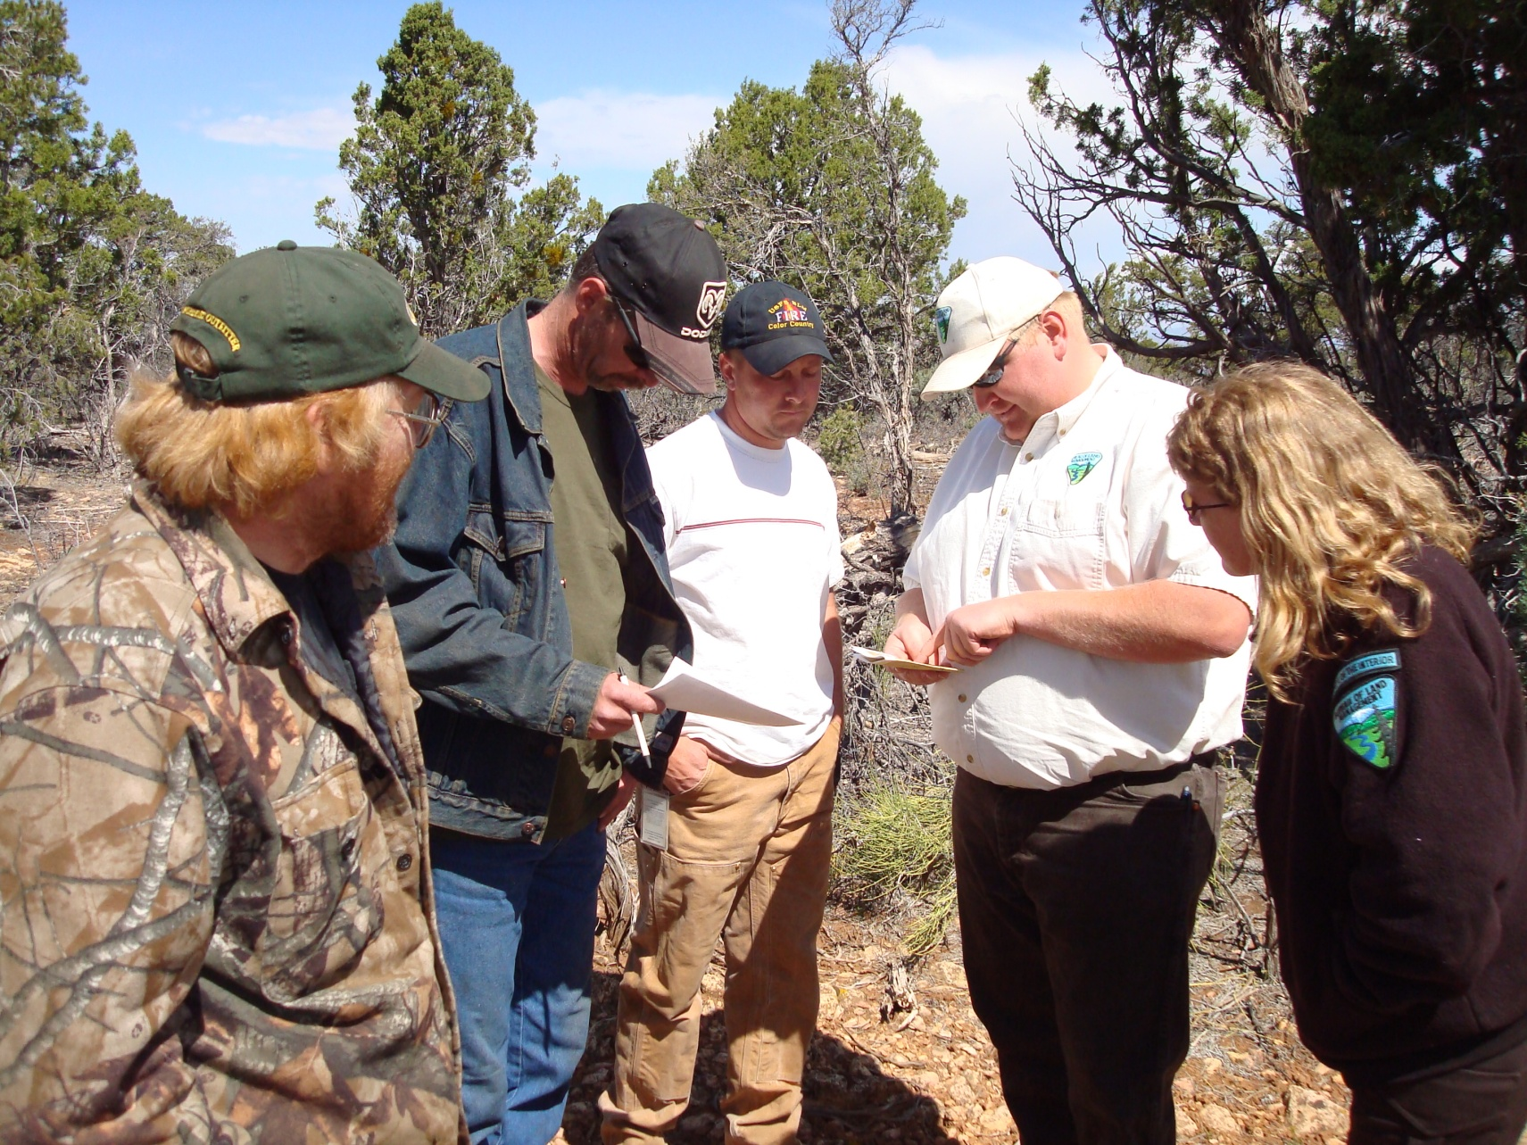
Task Order
Task orders will be issued with specific project location and details.
Firms may bid only for line items of work which were awarded as a result of the technical evaluation of the proposal submitted and in position to furnish.
For each task order a Statement of Work with specific details along with map of project will be provided.
Many times site visits will occur to the project with the release of a task order .
Notes:
Once a contractor has successfully made it through the solicitation, they have the opportunity to bid on individual task orders with items of work that was awarded as a result of the technical proposal. Photo is of a field trip to the project associated with the release of a task order.

Slide 21
Hazardous Fuels Reduction IDIQ Solicitation – Specifications
Notes:
This is the fourth subject area of the workshop and should be presented by a fuels specialist or fire management office that is familiar with most of the items within the solicitation. The contracting officer should be available if there are specific questions related to contracting. It is recommended that participants in the workshop have a copy of the solicitation to look at while going through this section.

Slide 22
Scope of Contract
Services in contract provide for wildfire hazard reduction, prescribed burning, and related services.
May include furnishing labor, supervision, transportation, operating supplies, and incidentals.
Notes:
Page 13 of solicitation under Description/Specifications/Work Statement.

Slide 23
Scope of Contract
Conduct slashing, girdling, lop and scatter, selective slashing, pruning, fuel modification zone construction, hand piling and cover, fire line construction and maintenance, fuels pullback, prescribed burning and mop-up, snag felling, roadblock removal/restoration, air curtain burner, and herbicide application.
Notes:
Type of general work to be performed.

Slide 24
Biomass Utilization
Where biomass is capable of being offered, unless the biomass is reserved for ecological reasons, the Contracting Officer may decide to include additional stipulations on removal methods, size limitations, or define additional protection measures.
Notes:
This is the Biomass Utilization clause in the solicitation. Additional details on the Utilization of Woody Biomass can be found at the end of the Item Descriptions on Page 46. This solicitation does not allow for Stewardship Contracting Authority.

Slide 25
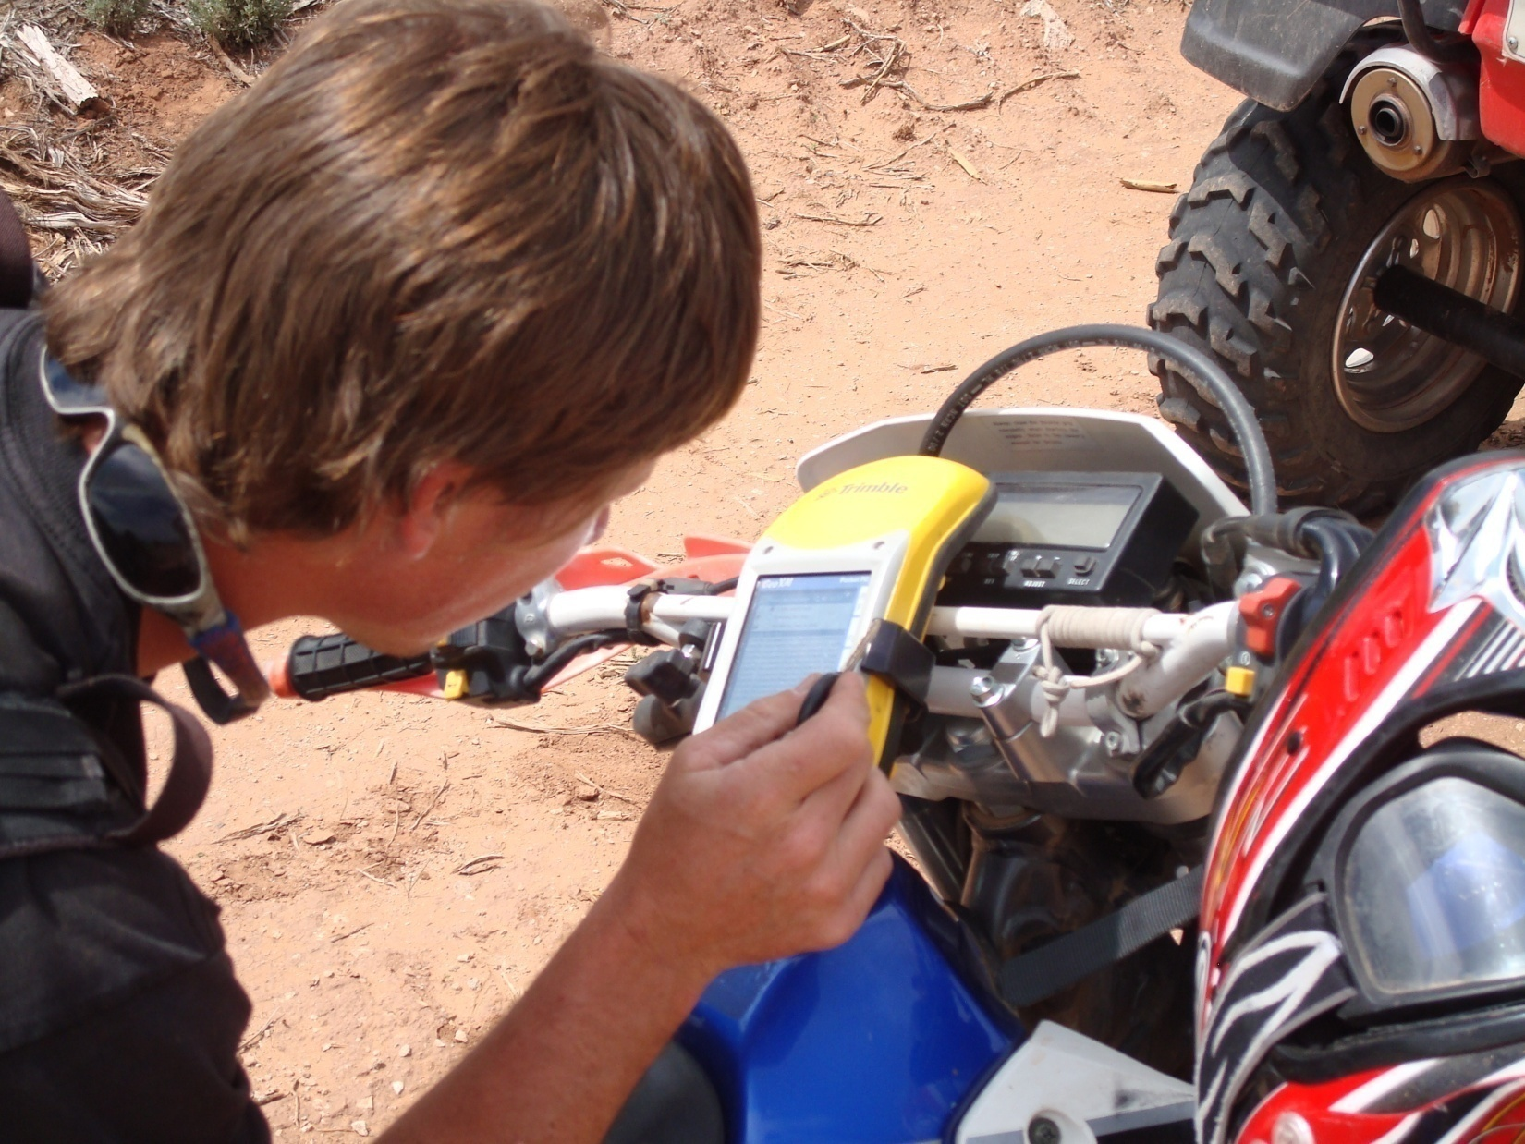
Boundaries of Project Areas
Notes:
Project boundaries are generally identifiable by changes in vegetation, roads, flagging, or through geographical information systems (GIS) data. Project maps will be provided for all projects. New under this contract is the ability of the government to provide boundaries through GIS data. This is at the government’s option and contractor will need to provide Global Positioning System (GPS) capable of uploading shape files.

Slide 26
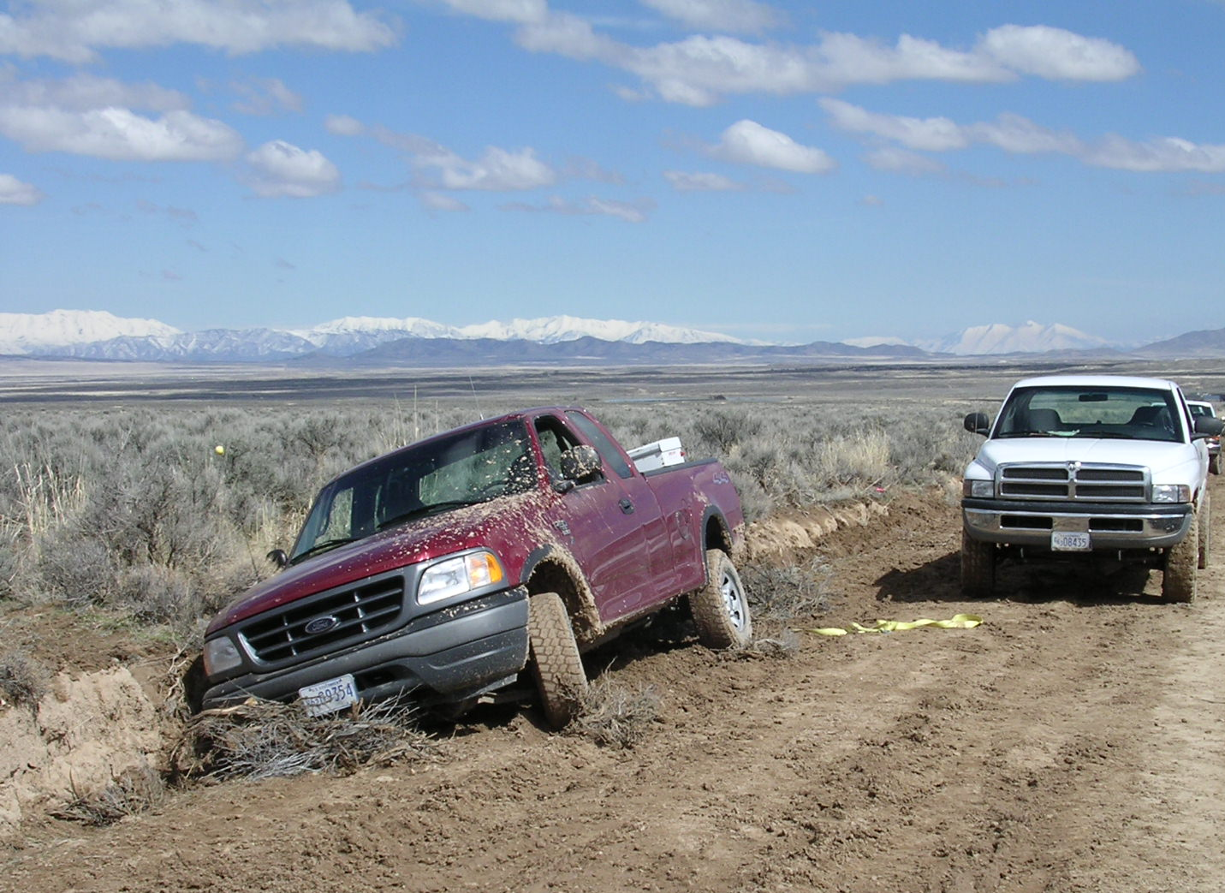
Access to Project Areas
All-weather and seasonal roads.
Project distance from 0 to 3 miles from access.
No access adjustment factor.
Suspend work order may be issued by the CO due to environmental conditions.
Notes:
There is not access adjustment factor included in this solicitation. This was added to the last solicitation, but became confusing. For the initial solicitation bid price, project distance from government provided access point should be considered to be from zero to three miles. Actual distance will be provided in the Task Order and contractors will need to factor into final bid price.

Slide 27
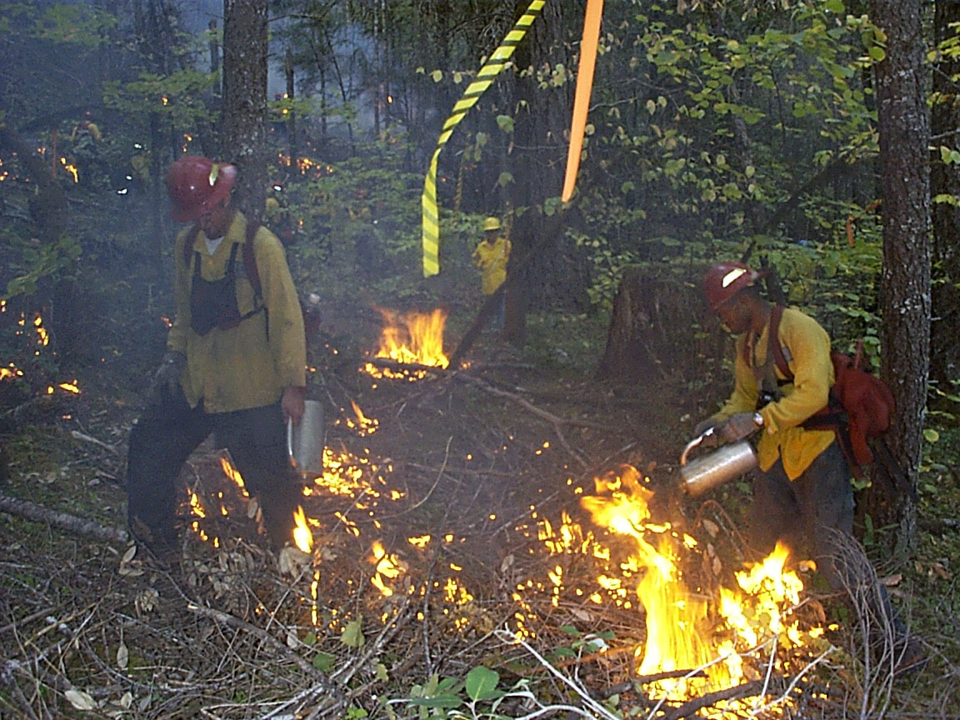
Unique Features of Project Areas
Standing timber and wildlife trees & snags.
Research plots, cultural sites, threatened and endangered species locations.
Cannot be disturbed during project activities.
Notes:
Unique features are items or areas that should not be disturbed when carrying out work under the solicitation.

Slide 28
Wildfire Guidelines and Procedure
Notes:
This provision primarily is for the Prescribed Fire Modules when a wildfire conversion occurs from a prescribed fire. Includes discussion on supervision and Emergency Firefigher Pay Rates.

Slide 29
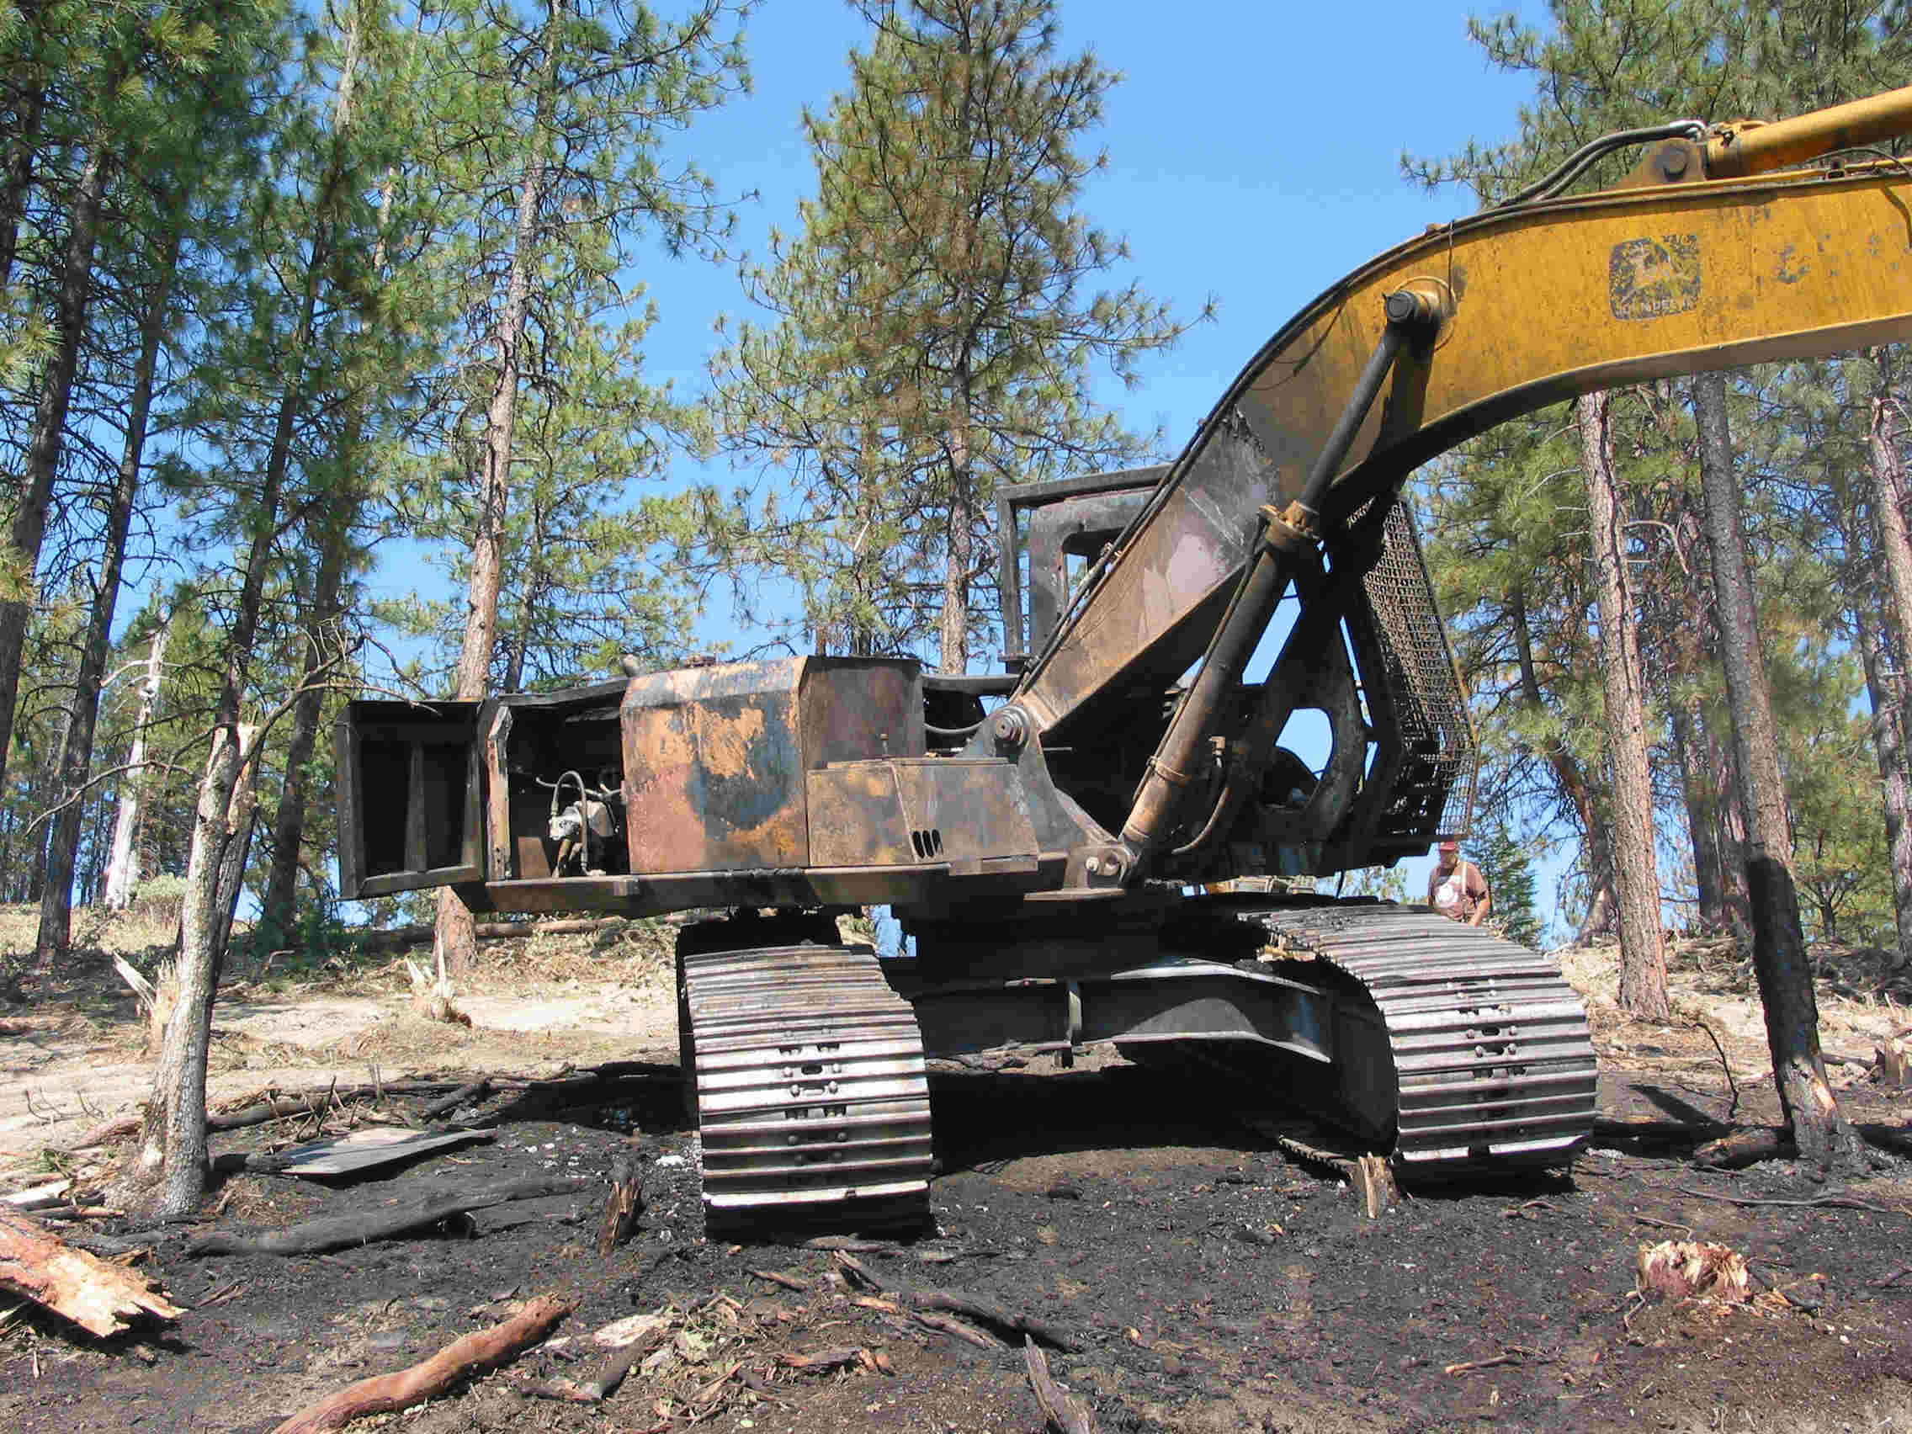
Fire Prevention and Liability
Contractor may be held liable for all operator starts and associated costs resulting out of the contractors operations with the exception of prescribed fire under the direction of the government as provided in the prescribed fire plan.
State and local fire prevention laws may exist and must be followed by the contractor.
The task order may have additional site specific prevention stipulations.
Notes:
Liability for operator starts and minimum fire prevention standards are covered under this discussion.

Slide 30
Hazardous Fuels Reduction IDIQ Solicitation – Specifications
Hazardous Fuels Reduction Request for Proposals includes:
29 Items
180 Levels
Notes:
The Hazardous Fuels Reduction IDIQ Solicitation includes 29 individual items with a total of 180 levels. The following slides and the solicitation provides general details on each item and level. Details for each project are outlined in the Statement of Work for each Task Order. Although you can bid on all items and levels for selected states, not all items will be ordered in every state. It is unknown at this time how many Task Orders for the following items may occur within a state. For individual workshops it might be useful to have a general knowledge of the type of work that has been ordered in the past.

Slide 31
Slashing – Item 01
Notes:
Cutting down trees and brush with the use of hand operated tools (i.e. chain saw). No live limbs can be left on the stump of any cut stem. Percent cover of total cover primarily determines levels with Levels 1-4 for forested stands and 5-8 for brush.

Slide 32
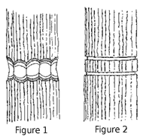
Girdling – Item 02
Notes:
Treatment may involve two chain saw cuts around the bole of each conifer tree or three horizontal cuts around hardwood trees. Can include a 4 to 6-inch wide horizontal band around each tree such that the cambium is removed. Cuts need to be made below the lowest live limb.

Slide 33
Lop and Scatter – Item 03
Notes:
Cutting of down woody material created from vegetation treatments (i.e. harvest, thinning, or slashing) or created through natural processes (i.e. blow down, wildland fire). Top and side branches need to be free of the central stem so that the slash is reduced to 12 to 20 inches of the ground as designated by the task order. Level of difficulty is based on tons of slash per acre and final height of slash.

Slide 34
Selective Slashing/Thinning – Item 04
Notes:
Selective Slashing/Thinning is similar to Item 1 Slashing, but in this treatment a specified amount of standing live vegetation is left standing. Level of difficulty is based on the expected number of leave trees per acre to be treated and/or spacing between leave trees, or the relative amount of material to be slashed.

Slide 35
Pruning – Item 05
Notes:
Designated vegetation shall be pruned of live and dead limbs and branches to a designated height measured above ground level. The designated height shall not exceed 12 feet above ground level, and will typically be designated to a height of from 6 to 12 feet. Limbs shall be cut cleanly and flush (as close) to the bole of the tree as possible. Material pruned shall be pulled back a minimum of 4 feet away from tree bole. The level of difficulty is based on the expected number of trees per acre (TPA) requiring treatment.

Slide 36
Hand Pile & Cover – Item 06
Notes:
Hand Pile and Cover involves the construction of piles and, if desired, covering of the piles. Level of difficulty for hand piling and covering is determined by the number of piles per acre expected based on the amount of slash on the unit. The Government will designate which specification for size of material and spacing of piles with each task order. In general all piles shall be constructed by laying limbs, stems, cut boles, and other slash in the pile so as to be triangular in shape, or as specified in task order. Each pile shall include an area of small sized slash to provide “kindling” for prompt ignition and to aid in combustion of larger slash. Maximum pile size shall be 10 feet in diameter by 8 feet in height, and minimum pile size shall be 7 feet in diameter by 5 feet in height at the time of final inspection. Covering piles is at the option of the government and will be specified in the task order. Cover material to be provided by contractor consisting of 4-mil polyethylene plastic or other material as specified in the task order. Piles shall not be closer than 10 feet to reserved trees or 25 feet to a unit boundary. Slash shall not be piled or placed on logs or stumps in roadways or drainage ditches or within channel bottoms or streams.

Slide 37
Slashing, Hand Pile & Cover – Item 07
Notes:
Slashing, Hand Pile, and Cover is a combination of Slashing (Item 1) and Hand Pile and Cover (Item 6).

Slide 38
Fuel Modification Zone (Timber) – Item 08
Notes:
Fuel modification zones (FMZs) shall be created to reduce adverse wildfire effects, limit rate of spread, and/or to establish defensible areas for use during fire suppression activities. Flammable material shall be treated and removed from the surface, understory, and canopy. Treatments required in this subitem include cutting of trees, slashing of shrubs and small vegetation, pruning of residual trees, and snag felling. FMZs will normally be created in whole or portions of stands, along ridgelines, between separate stand and vegetative types, or adjacent to private property. The level of difficulty for FMZs are based on percent cover of material to be treated. FMZ Construction is separated out by timber stands vs. woodland/shrubland.

Slide 39
Fuel Modification Zone (Wood/Shrubland) – Item 09
Notes:
Fuel modification zones (FMZs) similar to Item 8 but for woodland/shrublands.

Slide 40
Hand Cutting & Mechanical Piling – Item 10
Notes:
Treatment consists of hand cutting and mechanically piled materials with either a track or tire mounted swing. Level is based on the crown closure and slope of the area to be treated. Track or wheel mounted vehicle may be specified by task order.

Slide 41
Fireline Construction & Maintenance – Item 11
Notes:
Fireline construction and maintenance includes dozer and hand fireline. Hand fireline levels are based on existence of previous fireline, location in relationship to boundaries, and existence of slash. Firelines are bare mineral soil eight feet wide for handline and dozer blade width for dozer line. Both have an eight feet height requirement.

Slide 42
Fuels Pullback – Item 12
Notes:
Each tree/snag designated for pullback shall be cleared of all surface fuels, including litter, and aerial fuels from a 2-foot wide area, 8 feet in height, around the tree/snag. Material greater than 3" diameter within the clearing zone shall be pulled/rolled at least 4 feet from the bole. Levels are based upon number of trees per acre to be treated.

Slide 43
Prescribed Fire Module – Item 13
Notes:
A variety of activities associated with prescribed fire are included under this item and include burn site preparation, ignition assistance, holding assistance, burned unit patrol, and mop-up of burned unit(s). Prescribed Fire Modules include two, five, or 20 person crews, Type 6 or 4 engines, water delivery module, or water tender. Various National Wildfire Coordinating Group (NWCG) qualifications apply along with special equipment requirements. Prescribed Fire Modules are measured on a Daily Rate based on a 12 hour time period. Additional time beyond the 12 hour day will be compensated by 20% of the base rate. Time does not include travel to and from the project site.

Slide 44
Related Services – Item 14
Notes:
Related Services for Fuels Treatments includes a number of sub-items: Snag Felling, Tractor Operations, Lowboy Transport, Hauling Slash, Pile Relocation, and Air Curtain Burner. Snag Felling and Tractor Operations are measured on an hourly basis, beginning upon arrival at the access point to the unit, excluding lunch breaks and travel time, and ending when work is completed. Lowboy Transportation is per move. Hauling Slash is measured on tons per mile moved. Relocation of Piles is per pile. Air Curtain Burner is a daily rate, including mobilization costs and under this item, the Air Curtain Burner maybe operated by government employee or representative.

Slide 45
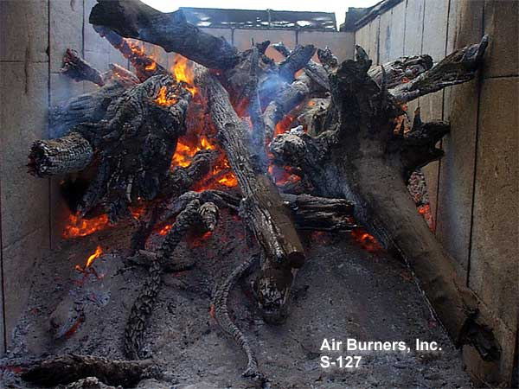
Air Curtain Burner – Item 15
Notes:
Air curtain burners are used in areas where smoke production is a concern as the burner provides for more efficient levels of combustion. The Level of difficulty is based on the relative tonnage of the material to be incinerated and location and access to the slash material.

Slide 46
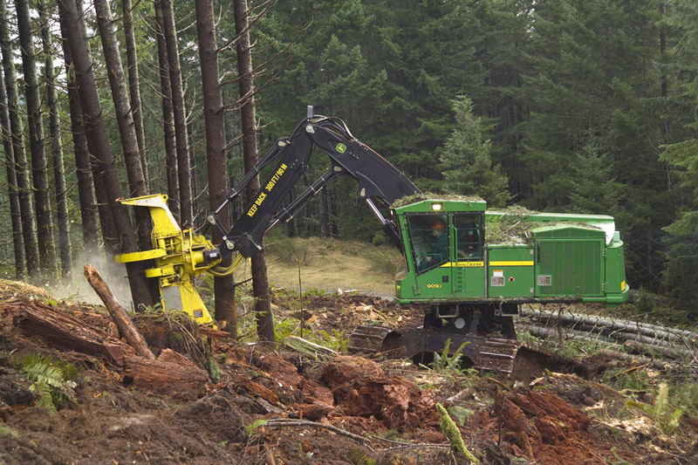
Mechanical Severing & Piling – Item 16
Notes:
Severing vegetation using a mechanical shear or saw followed by piling of the severed material. Specific type of mechanized equipment (i.e. track mounted swing, wheel carriage) may be specified in the task order. Pile location and size will be specified in the task order, but could be expected to range in size from 8 to 20 feet in height. Level of difficulty is based on the crown closure and slope of the area to be mechanically severed and piled.

Slide 47
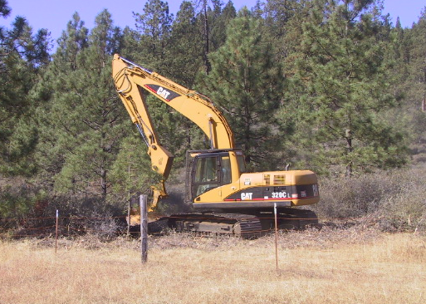
Mechanical Fuels Treatment (Grinder) – Item 17
Notes:
Grinding/shredding involves the mastication of material by a wheeled or tracked mounted vehicle equipment either hydraulic or PTO driven cutter head. Minimum head lift height of 12.5’ is required to alter the vegetation type in accordance with a specified level of work , prescription, or as otherwise specified in task order. Horizontal or vertical positioning of cutter head and tracked or wheeled equipment may be specified in task order. Level of difficulty is based on the total percent cover of material to be ground (chipped) and slope of the area to be treated by mechanical grinding on slopes below 46%.

Slide 48
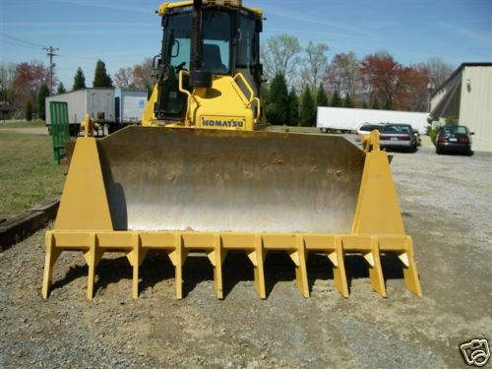
Mechanical Fuels Treatment (Piling) – Item 18
Notes:
Mechanical piling of already down woody material by an excavator with a swing device or rake equipped dozer. Specific equipment requirements will be specified in the task order. Level of difficulty is based on the unit density or amount of the material to be piled and slope.

Slide 49
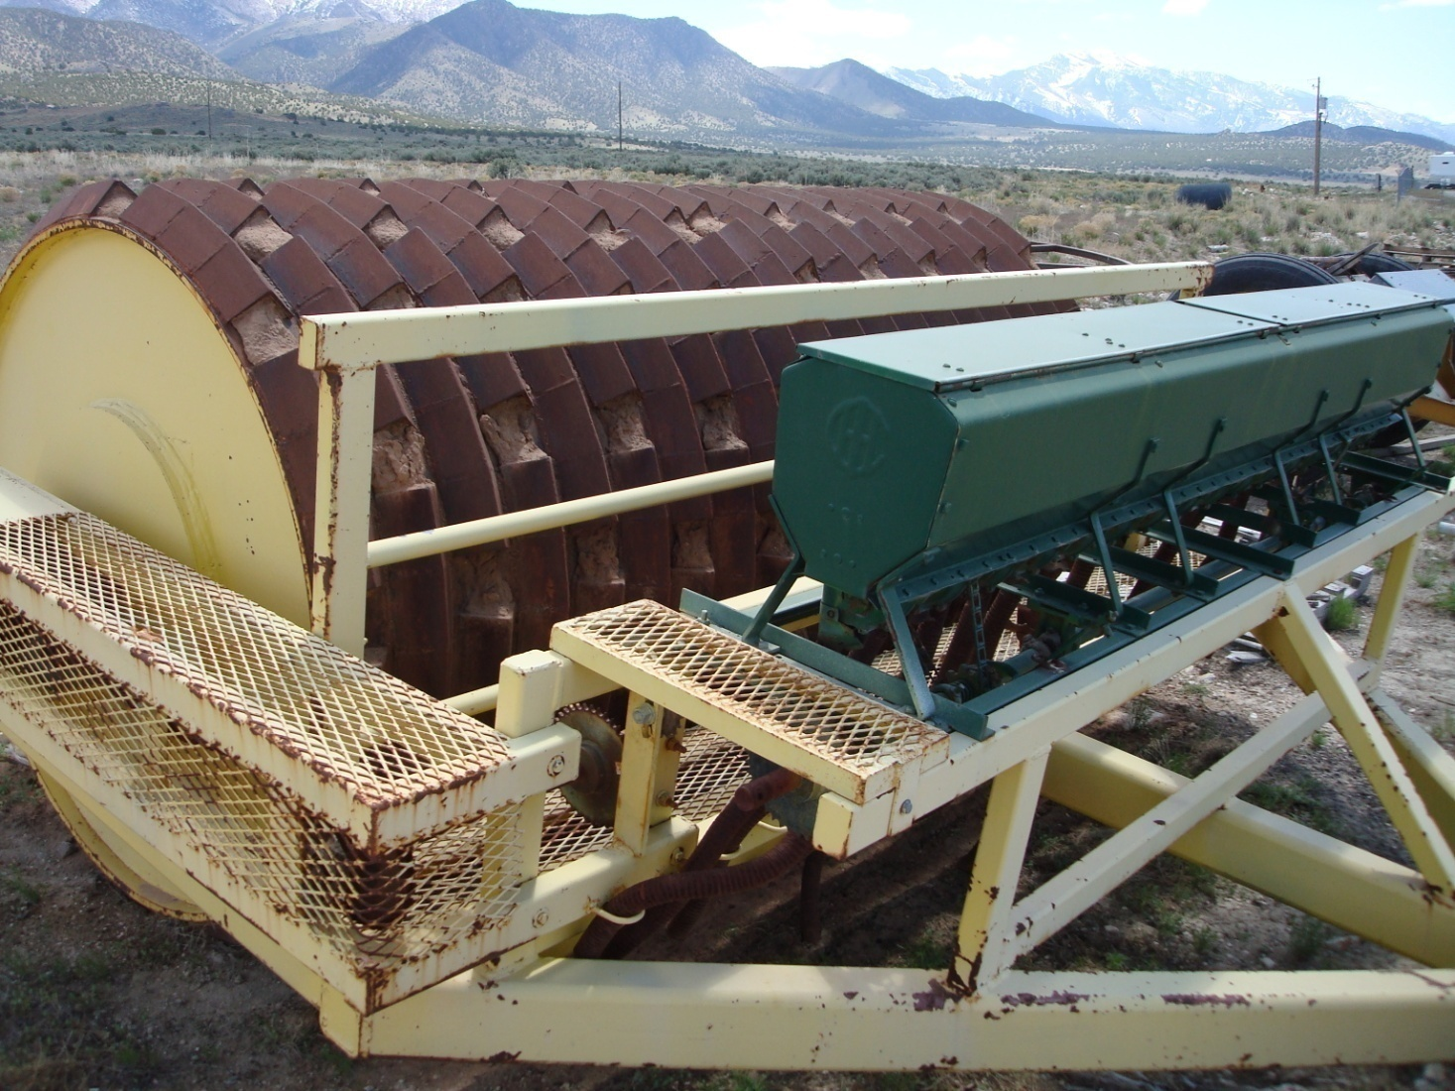
Mechanical Fuels Treatment (Crushing) – Item 19
Notes:
Vegetative material to be dozer crushed by a tomahawk-equipped dozer or equivalent crushing device on slopes under 30%. All live, standing vegetation, greater than 2 feet in height and 3 feet in length, but not over 6 inches DBH shall be completely severed with the stump height not to exceed 6 inches. Level of difficulty is based on percent cover and slope.

Slide 50
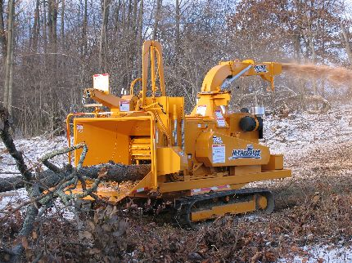
Mechanical Fuels Treatment (Chipping) – Item 20
Notes:
Mechanical chipping of all slash and brush including any cut vegetation or existing natural (dead and down) woody debris. Level of difficulty based on percent cover and slope. An hourly costs may be requested in task order under items or preparation for biomass utilization item.

Slide 51
Thinning, Pruning & Piling – Item 21
Notes:
Thinning, Pruning, and Piling is a combination of Slashing (Item 1), Pruning (Item 2) and Hand Pile (Item 6). The level of difficulty is based on the combination of the percent of total vegetation cover, number of trees per acre (TPA), and number of piles per acre.

Slide 52
Clear Cut & Scatter – Item 22
Notes:
Use mechanical cutting techniques to remove all vegetation by severing all trees and brush over 2 inches in diameter and scattering it. Level of difficulty is based on number of stems per acre.

Slide 53
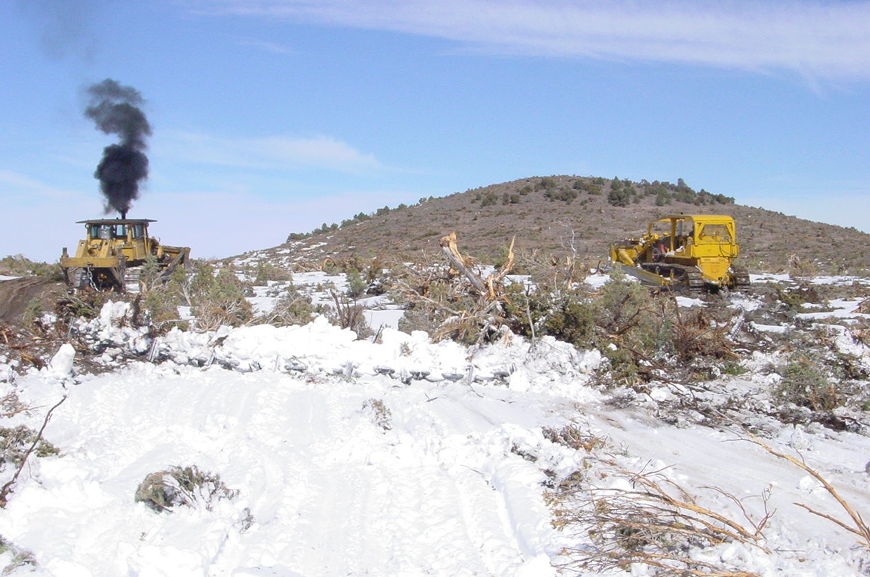
Mechanical Fuels Treatment (Chaining) – Item 23
Notes:
Chaining involves the use of two tractors (dozers) with an anchor chain pulled between the two pieces of equipment to uproot living and dead vegetation. Two tractors shall operate as a unit with one on each end of the chain. The tractors shall generally be operated parallel to each other, in an offset, or “J” pattern, although there may be occasions when a "see‑saw" type operation will be necessary. Chains maybe 180-500 feet in length with weights ranging from 60-140+ pounds per link (a link = about 20”) with tractors of a draw bar horsepower specified in the task order sufficient to pull the chain effectively. Task order to define type of chain supplied by the government (i.e. smooth or Ely Chain (Links with Railroad Iron cross bars welded to the links)). Level of difficulty is based on the terrain considering percent slope, occurrence and amount of rock, and number of trees and snags per acre.

Slide 54
Mechanical Fuels Treatment (Dixie Harrow) – Item 24
Notes:
The Dixie Harrow or equivalent is used to pull and/or sever brush out of the ground. Using a Dixie Harrow or equivalent involves pulling a 40-foot wide 12,000 lb. harrow with treatment typically done on the contour where possible to reduce or remove brush. Level of difficulty is based on percent cover and slope.

Slide 55
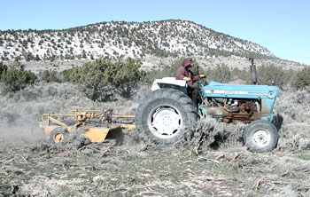
Mechanical Fuels Treatment (Mowing) – Item 25
Notes:
Mowing of perennial and annual grasses and/or brush by mechanical method. Beating or chopping is also included of brushy vegetation ½ to 3 inches in diameter at the base and up to 3 feet in height. Level of difficulty for mowing treatment is determined depth of grass or brush.

Slide 56
Mechanical Fuels Treatment (Grubbing) – Item 26
Notes:
Removal of tree/stump by mechanical means, utilizing dozer with root knife attachment, backhoe/trackhoe utilizing hoe, or any other tracked or rubber tired equipment. The level of difficulty and equipment requirements for grubbing/root knife are determined by tree density measured as stems per acre.

Slide 57
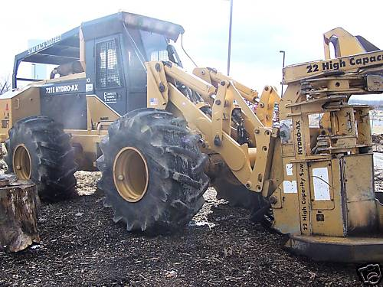
Partial Cut & Scatter – Item 27
Notes:
Mechanical cutting techniques (such as hydro axe, feller buncher, etc.) to remove vegetation. Level of difficulty for partial cutting is based on percent cover and the expected number of leave trees per acre to be treated and/or spacing between leave trees.

Slide 58
Spot Application of Herbicide – Item 28
Notes:
Spot application of herbicide involves cutting and painting stumps or spot spraying for basal bark/foliar application. Level of difficulty is based on the expected number of trees or clumps per acre to be treated with herbicide, and whether the treatment is cut stump or basal bark application. Cut stump application will require cutting a stem and painting the end of the stump with the herbicide specified in the task order. Basal bark/foliar application will require spraying the basal bark area of the targeted tree or shrub with a backpack pump or four-wheeler mounted sprayer. The government will provide the herbicide required for the treatment. The contractor must meet the required State Pesticide Application certification requirements and present documentation when bidding on tasks.

Slide 59
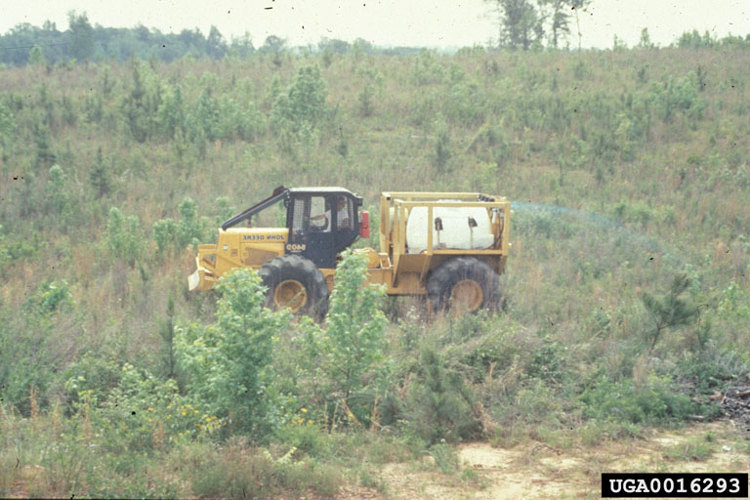
Broadcast Ground Application of Herbicide – Item 29
Notes:
Broadcast ground application of herbicide level of difficulty is based on the number of acres to be treated and number of treatments. A second application will only be done if further control is required. Specific application techniques, season of application, herbicide formulations and species to be sprayed will be outlined in the task order. The government will provide the herbicide required for the treatment. The contractor must meet the required State Pesticide Application certification/license requirements and present documentation when bidding on tasks.

Slide 60
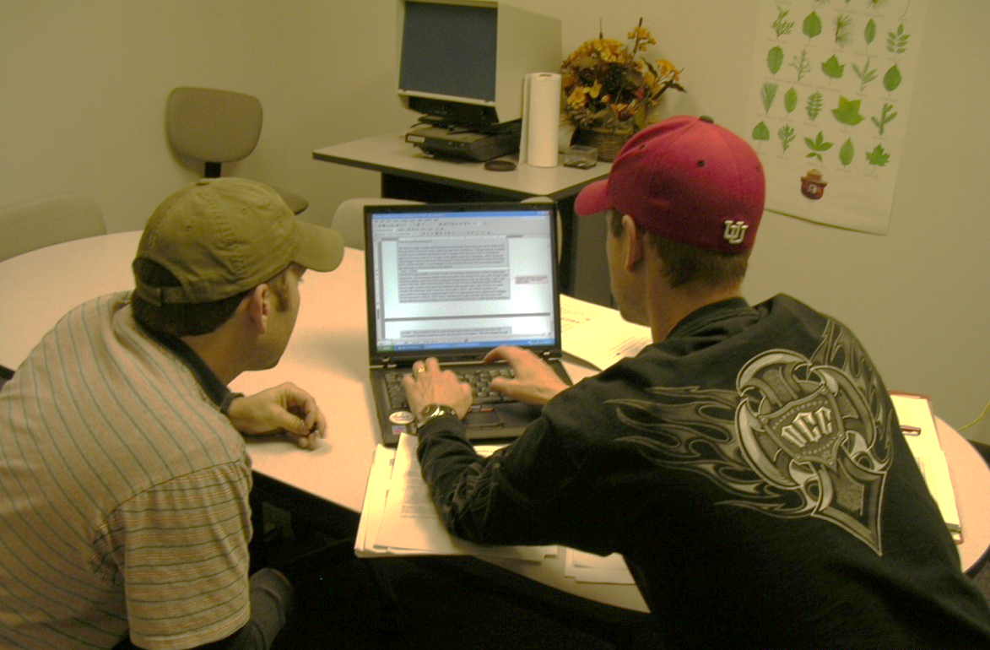
Contract Language and How to Prepare a Solicitation Package
Pages 61-63.
Notes:
The following section goes through the steps required in preparing a solicitation.

Slide 61
Solicitation Instructions
In order to be considered eligible for award, offerors shall accomplish the following:
Ensure contractor is currently registration at http://www.ccr.gov.
Complete blocks 17A (including DUNS (Dunn & Bradstreet) number in block labeled "CODE"), 30A, 30B and 30C on Form SF1449 - Solicitation/Solicitation/ Order http://www.dnb.com/
Notes:
Contractors must be registered in CCR and have DUNS number.

Slide 62
Solicitation Instructions
Under the section entitled, "Notices to Offerors", perform the following:
Insert a dollar amount in the "Task Order Maximum Dollars".
Identify states you wish to be considered for work under "Place Of Performance".
Identify line items your proposal is being offered for in "List Of Line Items".
Notes:
This section is taken from pages 2 and 3 of the solicitation.

Slide 63
Solicitation Instructions
Provide one price for all states under "Base Year Unit Fixed Price", “Option Year I Unit Fixed Price" and "Option Year II Unit Fixed Price" listed under "Supplies/Services And Prices" for all line items you are proposing on.
This will be the MAXIMUM price for any state that you are proposing on.
Price includes mobilization costs.
No future increases will be accepted under any circumstance.
Notes:
Complete pages 5 through 12 of the solicitation.

Slide 64
Solicitation Instructions
Provide a Technical and Past Performance proposal in accordance with the provision entitled "52.212-02 Evaluation – Commercial Items".
Complete the provision entitled "52.212-03 Offeror Representations and Certifications – Commercial Items".
Notes:
Section 52.212-02 EVALUATION – COMMERCIAL ITEMS is found on pages 62 and 63 of the solicitation.

Slide 65
Solicitation Instructions
Four copies must be RECEIVED by 26 October 2009 at:
Bureau of Land Management, OC-663
Building 50, Denver Federal Center
P.O. Box 25047
Denver, Colorado 80225-0047
Notes:
Emphasis that proposals must be RECEIVED by the National COR in Denver on 26 October 2009. Contractors should account for time for mail service delivery.

Slide 66
Evaluation – Commercial Items
Contracts resulting from this solicitation will be awarded to the responsible offerors whose offer conforming to the solicitation will be most advantageous to the Government, based on price and other factors.
Technical, Past Performance, and Price factors shall be used to evaluate offers.
Notes:
This is a performance based solicitation with technical, past performance, and price being factors considered in the award.

Slide 67
Technical
Personnel
Equipment
Utilization of Small and Local Business Concerns and Hiring of Local Employees and Product Processing
Notes:
Each of these areas are included in the technical review and will be covered in more detail in the following slides.

Slide 68
Personnel
Contract Manager for the Contractor – one page resume
On site job superintendent for the Contractor – one page resume
Number of full time employees to be used for this project
Number of part time employees to be used for this project
Notes:
Resumes should be no more than one page for the contract manager and superintendent with numbers provided for other full and part time employees.

Slide 69
Personnel
Prescribed Fire Modules – Provide additional documentation for personnel qualifications and experience (Single Resource Boss (CRWB and ENGB), Advanced Firefighter/Squad Boss (FFT1), and Prescribed Fire Crew Member (FFT2 - Firefighter))
Supervisory Positions - The name, specific qualifications, credentials and level of experience practical or educational, for the person(s) who will be assigned to supervisory positions.
Crew Member Positions - The numbers, training, and experience levels of the crew members.
Identify if workforce are current employees, subcontractors, or will be hired locally if you are awarded this solicitation.
Notes:
Prescribed Fire Modules have additional NWCG fire qualification requirements.

Slide 70
Equipment
Answer only those questions pertinent to items bidding.
List of hand tools to be used on the job that are owned.
List of hand tools to be used on the job that will be either rented or purchased.
Attach a list of vehicles including make and model that will be used on the job.
Attach a list of mechanical equipment to be used on the job, if any.
Notes:
If Contractor only desires to bid on one or several item (i.e. Contractor has several masticators and only desires to bid on Item 17 – Grinding). Contractor would only need to address pertinent questions in technical proposal (i.e. would not need to address hand tools to be used).

Slide 71
Utilization of Small and Local Business Concerns and Hiring of Local Employees and Product Processing
The plan for providing employment opportunities to people in the local rural communities and plan for providing training opportunities to those people in local rural communities.
Use and involvement of local American Indian tribes, personnel, and business.
Significant use of local business for product processing.
Use of local small business.
Knowledge of and ability to integrate into the local culture and insure that the project is embraced locally.
Notes:
Increase local capacity has an economic element with contracting to local interests and bringing funding into the local economy is a significant consideration under the 10-Year Comprehensive Strategy. This element provides an opportunity to show how contractor will fulfill this concarn.

Slide 72
Price
Reasonableness will be established by the existence of adequate price competition and by comparing all of the proposed prices.
The Price factor is not numerically weighted or scored.
The realism of proposed prices may significantly affect the final selection for award.
Material unbalancing between line items may be cause for rejection of the offeror’s proposal.
Technical and past performance, when combined, are significantly more important than price.

Slide 73
Past Performance
Three past performance questionnaires evaluating services within the past three years are required for each offeror.
If less than three questionnaires are received, the offeror will receive a neutral past performance rating.
Responses to questionnaires obtained by the Government from sources other than those provided by the offeror may be included.
Notes:
Past performance is an important element when reviewing a potential contractor.

Slide 74
Assistance from the State Procurement Technical Assistance Center
Help small businesses with all phases of Government contracting - federal, state, and local.
Counselors provide one-on-one and group instruction that helps clients identify contracting opportunities.
PTAC Services:
One-on-one counseling
Registration Assistance (Duns, CCR, ORCA)
Bid Proposals (response to an RFP)
Solicitation Review
Product Specifications / Standards
Procurement Histories / Pricing Data
http://www.dla.mil/db/procurem.htm
Notes:
It is strongly recommended to have a local PTAC representative at your workshop. If unavailable, contact information would be good to provide.

Slide 75
Questions

